Slide 1











USE CASE DIAGRAM
Organic Waste
Paper Waste
Vermicompost
Biogas
Recycle
Manure
Electricity
Profit
Public
Profit

Slide 2

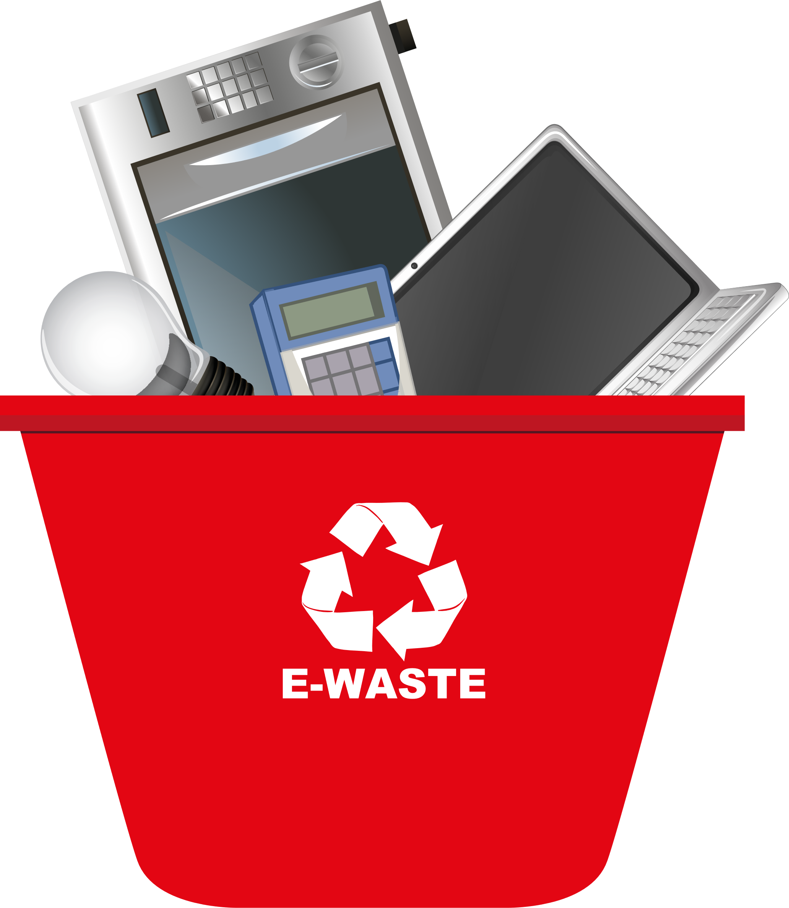
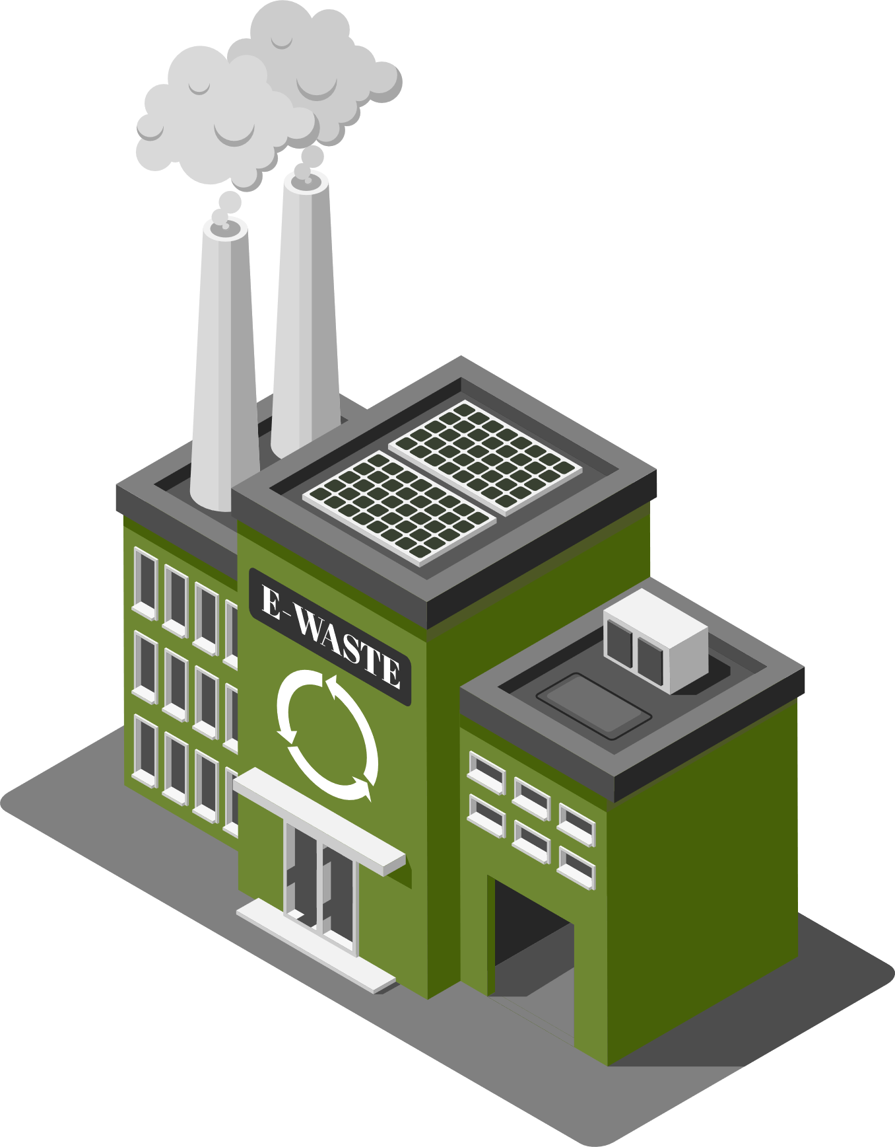
USE CASE DIAGRAM
Recycle
E-waste Industries
Profit
Profit
Public

